Slide 1
Evaluating within complexity Role of evaluation in NSW natural resource management Todd Maher & Ria Pryce NSW Natural Resources Commission AES conference, Sydney 2011

Slide 2
NRM – ‘it ain’t simple’
PROGRESS?
Different world views
Linked social & ecological systems
Deckchair reshuffles
Land use planning
Monitoring and Evaluation
Water planning
Stewardship

Slide 3
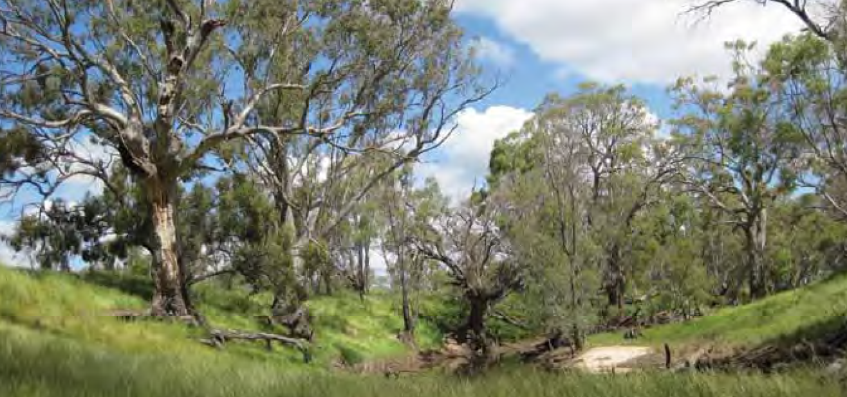
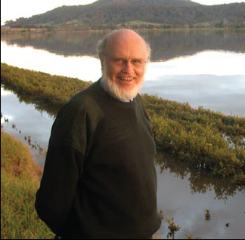
Quick tour of NRM NSW
Catchment Management Authorities Act
NSW Government and agencies
Source: Central West CMA
Native Vegetation Act
Natural Resources Commission Act
Australian
Government & agencies

Slide 4
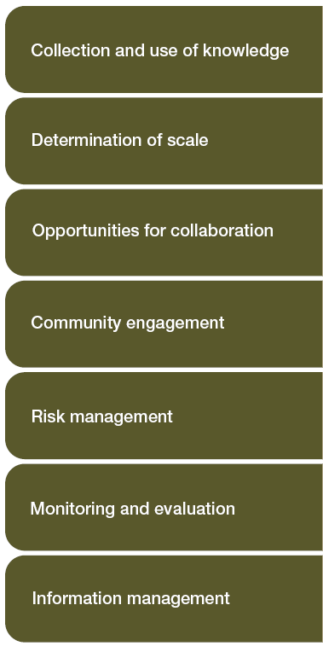
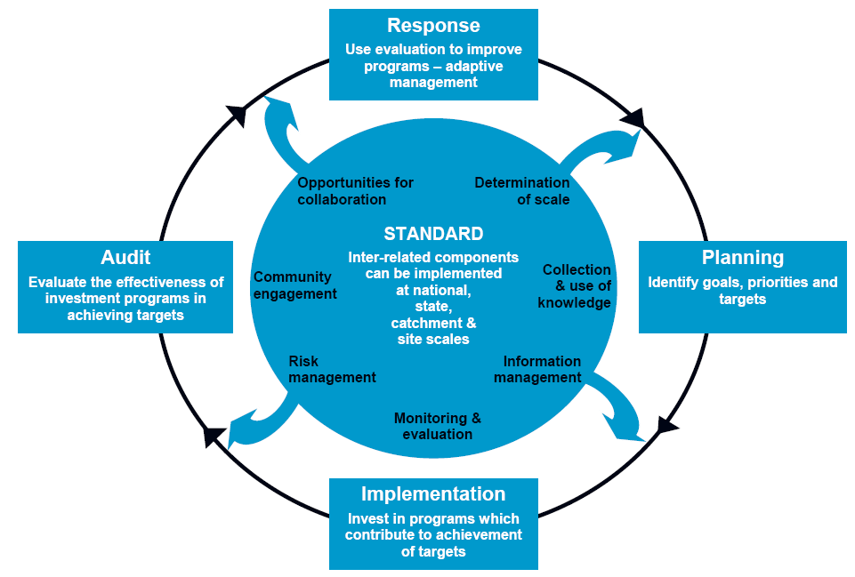
The standard:

Slide 5
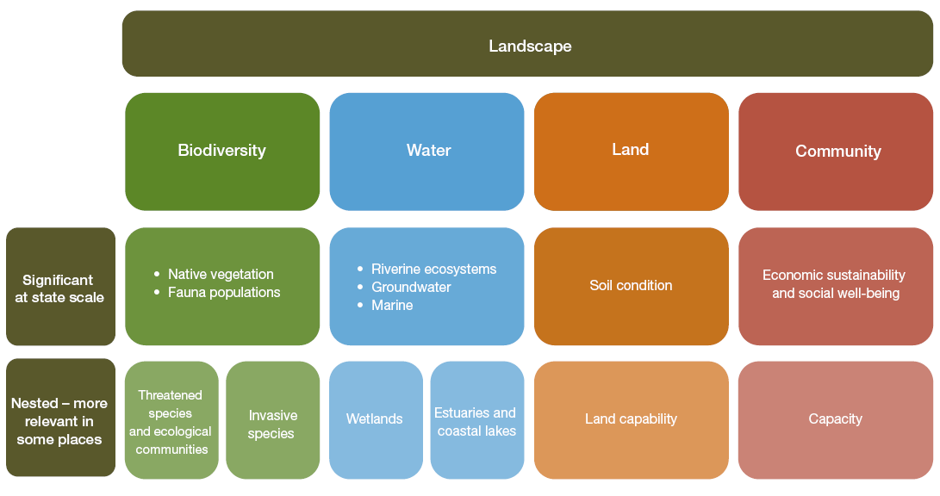
The targets:

Slide 6
How they fit
What is working
What needs fixing
What might fix it

Slide 7
What have we done
2006 - Reviewed and advised whether to approve 13 catchment action plans
2008 - Audited and reported on the implementation of 13 catchment actions plans
2006/08/10 - Reported on progress and areas to improve 3 times
Moving into next phase of reviews, audits and progress reporting

Slide 8
How we did it – generic model

Slide 9
How we did it - audits
4 lines of inquiry, across 13 criteria
- Prioritisation
- Project delivery
- Community engagement
- Adaptive management
Mix of audit specialists and NRM experts
Over 100 site inspections across the state

Slide 10
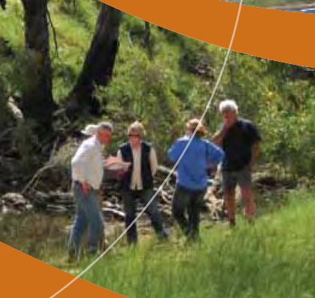
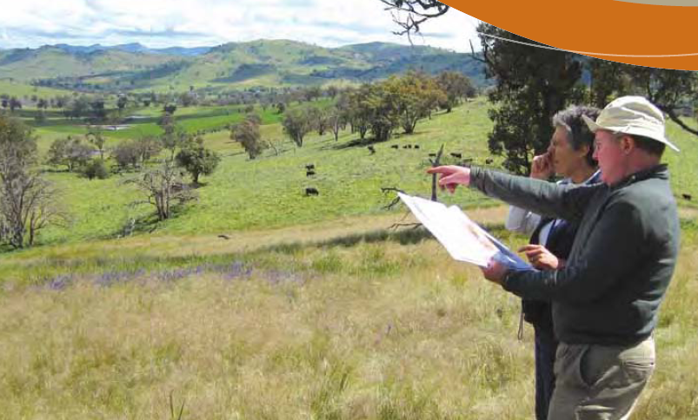
How we did it

Slide 11
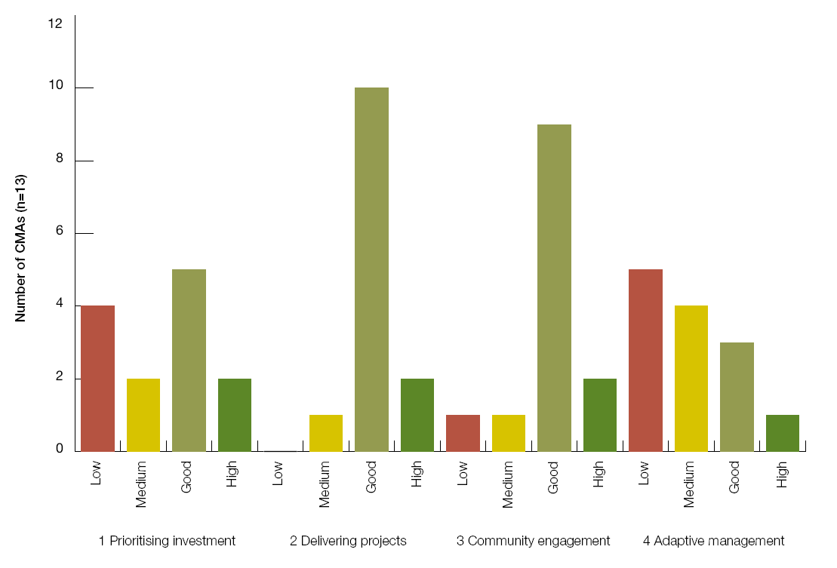
What’s working & needs fixing

Slide 12
What need fixing

Slide 13
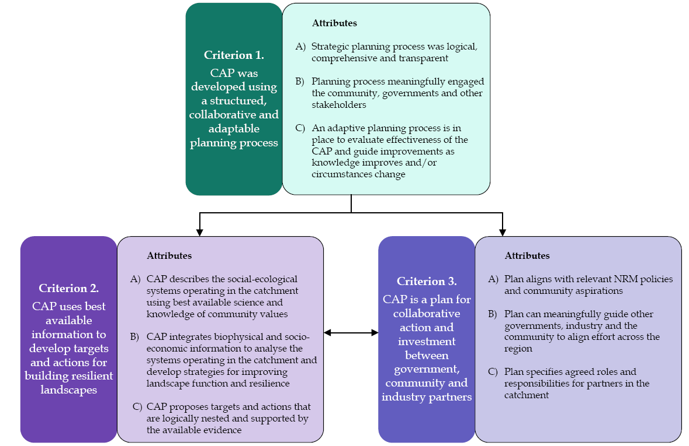
How to fix it

Slide 14
How to fix – the bigger picture

Slide 15
Parting thoughts
Co-learning – the evaluator needs to learn and adapt in complex spaces too
‘Room’ – need appropriate space and information so parties can progressively work together to solve problems and learn…but you still need some ‘accountability’ boundaries
Value proposition – evidence of progress is good but the ‘what and how to fix’ is important
Trust and credibility – takes time

Slide 16
Thank you
www.nrc.nsw.gov.au
todd.maher@nrc.nsw.ogv.au
ria.pryce@nrc.nsw.gov.au

